Slide 1
TWITTER SENTIMENT ANALYSIS FOR ELECTION PREDICTION
SUBMITTED BY:
SANGHAMITRA HOTA(1501106521)
SHIMONA ELORA (1501106526)
TULSI ACHARYA(1501106538)

Slide 2
PRESENTATION OUTLINE
MOTIVATION
PROCEDURE
REQUIREMENTS
PROGRAM
ANALYSIS
RESULTS
FUTURE ENHANCEMENT
CONCLUSION

Slide 3
MOTIVATION
In less than 20 days the indian citizens are going to vote for the general election 2019.
The traditional method of collecting views of people around the country is time taking and costly.
For accurate and easy method of analysing people view and sentiments we use the twitter sentiment analysis.
Getting political views from twitter is easy as we get a huge number of views from the people in the social media platform.

Slide 4
PROCEDURE
Data collection is one of the first and foremost process.We can either do it by searching the keywords or by using the twitter API to find a specific data and save it in the database.The second process is helpful for data extraction and analysis
DATA COLLECTION
Sentiment analysis are of two types either by the use of machine learning methods using naive bayes algorithm,where we calculate the probability of occurrence of events or the lexical analysis phase which is a dictionary search method where it check positive and negative hashtags of different word.
Before analysis the data it needs to remove the stop word,then stem the word and form them into separate tokens which will be used in the further process of analysing the data
SENTIMENT ANALYSIS
PRE-PROCESSING

Slide 5
REQUIREMENTS
NLTK
NLTK stands for Natural Language Toolkit.
It is one of the leading platform for natural language processing.
This package is used to tokenize the sentences and save them in a form for array of words, remove stop words
Helps to get structured data from unstructured (raw) data.

Slide 6
TWEEPY
It is the package which will help to mine the data from twitter.The first thing to do is to get the consumer key,consumer secret,access key and access secret from the developers account. Now in order to authorize our app to access Twitter on our behalf, we need to use the OAuth Interface. Tweepy provides the convenient Cursor interface to iterate through different types of objects. Twitter allows a maximum of 3200 tweets for extraction.

Slide 7
FLASK
Flask is based on Werkzeug WSGI toolkit and Jinja2 template engine.The flask framework is used to handle the server side processing.Our code will receive requests. It will figure out what those requests are dealing with and what they are asking. It will also figure out what response to send to the user.

Slide 8
PICKLE
Python pickle module is used for serializing and de-serializing a Python object structure. Any object in Python can be pickled so that it can be saved on disk. What pickle does is that it “serializes” the object first before writing it to file. Pickling is a way to convert a python object (list, dict, etc.) into a character stream. The idea is that this character stream contains all the information necessary to reconstruct the object in another python script.

Slide 10
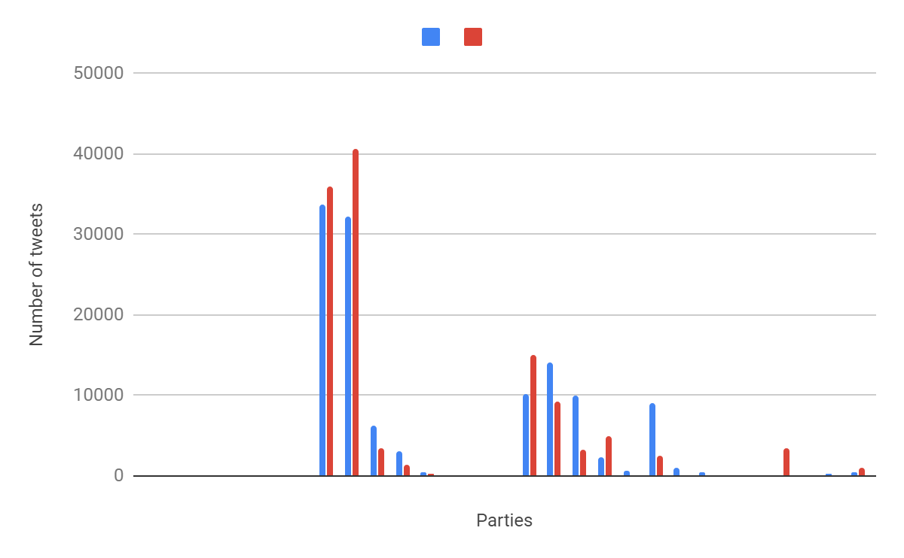

Slide 11
FUTURE ENHANCEMENT
This is just a general representation of the election prediction .
We can take various other situations like coalitions and change of members from one party to another
We can increase the number of tweets and the processing can be done with an interval of less number of days so that we can analyse more number of tweets and have a more accurate idea
We can include multiple conditions to filter the tweet so that we can calculate the elections of any specific place based on certain criteria

Slide 12
CONCLUSION
Twitter sentiment analysis helps us to get a accurate idea about the inclination of the people.We can not only use this method to predict election but also use it to calculate opinions of people about different social and political issues.
This process gives a general idea about the public view.With careful and precise analysis parties can find out their success as well as failures which affects the people’s sentiment and form a better strategy.

Slide 13
THANK YOU

